Slide 1

Notes:
You know all those orange barrels that you see as you’re driving around Dallas and Fort Worth? You might call them a good example of a necessary evil … Something we just have to put up with in the name of progress and economic growth. And that growth is forcing us into some decisions. But before we make any of those decisions, we should all be well-informed about what they will mean – now and years into the future. That’s why I’m visiting with you today … to share some straightforward information about the challenge we face, what choices we have and how that might involve doing things a little differently than we have in the past. I’m here because we need you to contribute informed viewpoints on policy decisions that will determine how the state’s most urgent transportation needs will be met, and how they should be paid for.

Slide 2
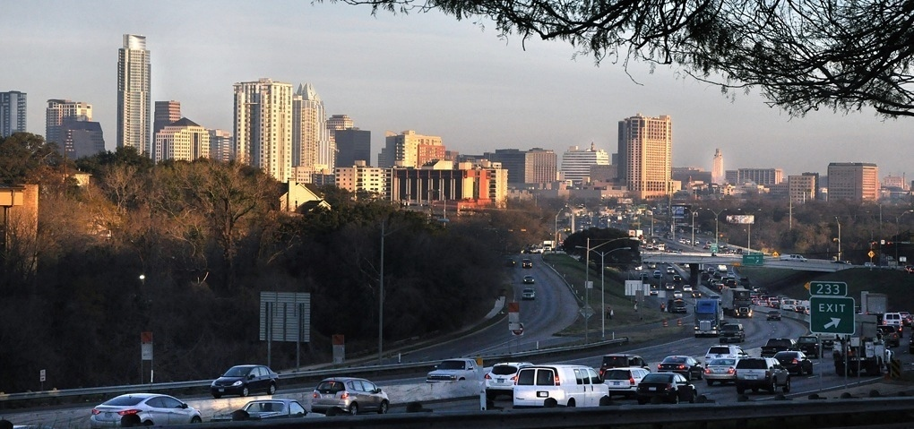
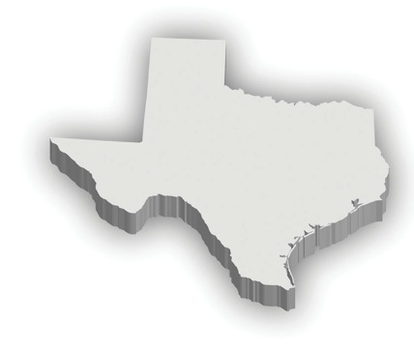
Texas has a long legacy of good roads
Symbol of our economic prosperity, attracting jobs and people to the State
Our roads are used by you to get to work, home, school or recreation
Notes:
We can justifiably take pride in how Texas has been a leader in building and maintaining good roadways. Thanks to that leadership, we have the kind of transportation system that attracts more people to move here. We’ve also been successful in attracting businesses to move here and keep our job market strong. That means that we have that many more people who need our roadways to do just about everything.

Slide 3
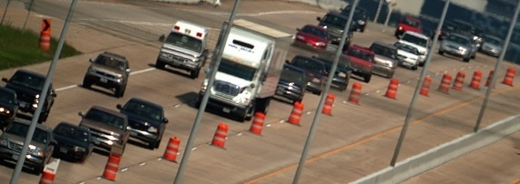
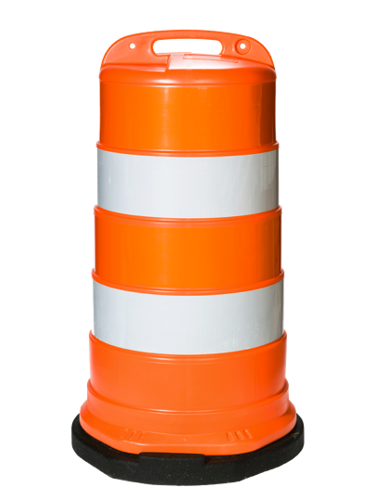
Transportation in Texas is stretched to the limit, and the news gets worse
Don’t let those orange barrels fool you
Building highways on borrowed money
Notes:
But economic prosperity and population growth are putting a huge strain on our highway system. It’s not a pretty picture, and it’s getting worse, because the state is running out of ways to pay for improvements, and revenue will not continue to increase, so it will be much harder to keep up with the population and business growth that we’re all seeing. All of that is forcing us to re-think the path that we’re on. … But for now, if you look around, you’ll see orange barrels … because we’re building and expanding highways right now. So based on what you see, it’s fair to ask “Why should I be worried?” I’ll tell you why … Because the state has been building highways on borrowed money and we’ve reached the limit on the state’s credit card. Everyone here who has taken out a car loan or a mortgage knows that once you pay off that car or that house, they end up costing a whole lot more than if you had paid for them in cash. The same is true when the state borrows money to build highways. You see lots of orange construction barrels today, but those barrels might just be on the path to extinction.

Slide 4

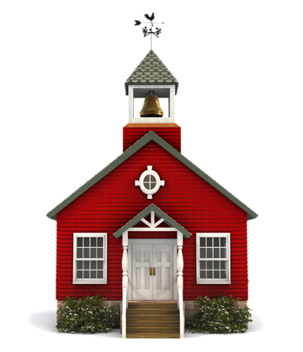
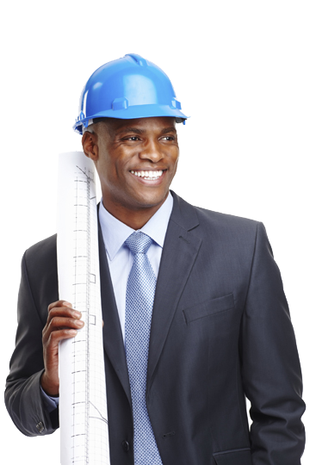
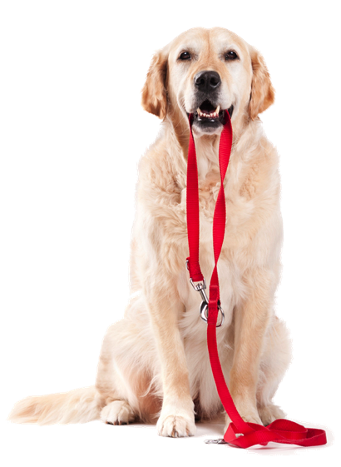
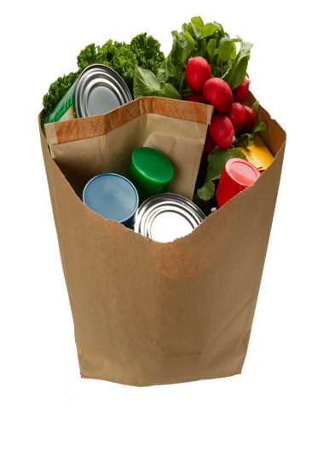
At stake is the lifestyle we want to enjoy in Texas
Notes:
There’s a lot at stake, starting with quality of life. We need a reliable transportation system to help us get to where we live, learn, work, play and shop. And we don’t want to just “get there” – we want to get there safely and predictably.

Slide 5

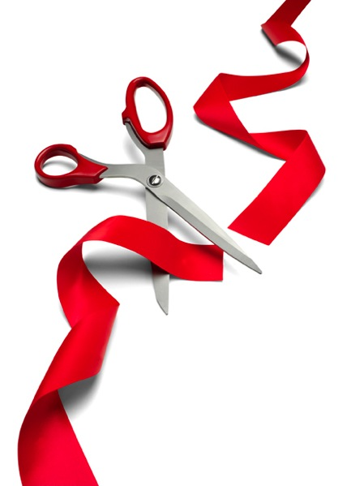
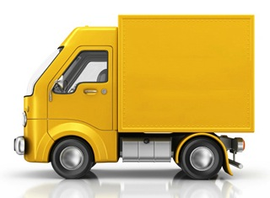
At stake is the economic health of Texas
New Lower Shipping
Jobs
business
costs
Notes:
And there’s something else very important at stake – our economy. We need a good highway system not only to attract new businesses to Texas, but also to keep those jobs and businesses from going somewhere else. We need reliable transportation to help us do our jobs. And we need reliable transportation to keep shipping costs under control.

Slide 6
What’s the
problem?
Congestion in Texas each year
472 million extra hours of travel time
$10.1 billion in delay and wasted fuel costs
$2.1 billion in truck freight moving costs
Notes:
The challenge we face should not surprise anyone in this room who travels regularly in our state’s biggest cities. Traffic congestion in those cities has gotten so bad that we now spend 472 million hours every year sitting in traffic. That’s costing our state more than ten billion dollars every year in wasted fuel and other delay costs. It’s costing us more than two billion dollars in the costs of moving freight.

Slide 7
Dallas-Fort Worth
Traffic delays
cost every commuter
$1,000
each year
That’s 45 hours per commuter
Notes:
What does that mean to you personally? It means about a thousand dollars out of your pocket every year, and 45 hours that you will never get back. That’s about 4 hours each month and less cash for you to spend on things other than sitting in traffic. Remember those orange barrels? Well, even if we stop building highways and those barrels go away, the population growth will continue, and these numbers will only get bigger.

Slide 8


What’s the
problem?
Safety and maintenance
More than
Nearly
Well-maintained roads=
3,000
80,000
crash deaths in 2011
serious crash injuries
safer roads
Notes:
But it’s not just about traffic jams. It’s also about safety. Based on the most recent count, more than three thousand Texans are killed in roadway crashes every year. Add to that almost eighty thousand serious injuries. Here’s the point -- The more strain we put on our transportation system, the more wear and tear we can expect. It’s very important that we keep those roads in good condition, because well-maintained roads are safer roads.

Slide 9
How did we get in this hole?
It’s all about supply and demand
238%
172%
125%
19%
population
vehicles
highway use
highway space
Notes:
So then, hopefully we can all agree that we have a problem. So the logical question is -- How did we get in the hole we’re in? And the answer is -- It’s all about supply and demand. Over the past 40 years, our population has more than doubled – up by 125 percent. The number of cars and trucks on the road has almost tripled. And the number of miles those cars and trucks travel has more than tripled. Over the same time, our roadway capacity has barely grown at all -- only 19 percent. We just have too much demand for roadway space and not enough supply. It’s that simple. And it’s one more reason why it’s time to re-think the way we’re doing things.

Slide 10
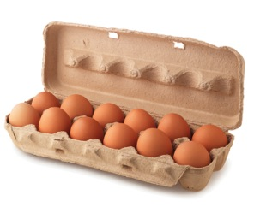
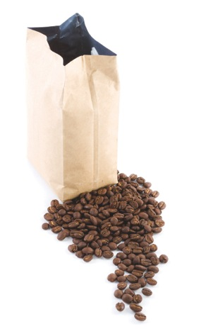
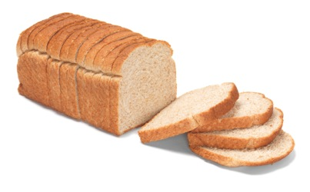

How did we get in this hole?
Since 1991, the cost of everyday goods has about doubled
So has the cost of building roads
Notes:
The state has many more demands on its transportation system at the same time that everything is costing more. Think for a moment about what we might pay today for a house, or a car, or the groceries we buy. The price of just about everything we need is about twice what it was twenty years ago. The same is true for the cost of building highways. And the way we pay for our highways is mostly through the gas tax.

Slide 11
How did we get in this hole?
Financing
for our roads is stuck back in the last century
$3.26
$1.10
Gallon of Gas
Gas Tax Portion
1991 2014
Notes:
Climbing out of this hole will not be easy, especially when you consider this – the tax we pay at the gas pump is not like the sales tax we pay at a shopping mall. The federal and state gas tax together is now 38 cents, and it’s the same no matter what a gallon of gas may cost. And mostly because of inflation, that 38 cents buys much less than what it once did. The state gas tax has not been raised since 1991, and the federal gas tax has not been raised since 1993. And why is that a big deal? It’s a big deal because the gas tax is the primary source of money that the state uses to pay for transportation – that’s everything from highways to bike routes to sidewalks. Imagine being in a job where your paycheck stayed the same for 20 years, but the cost of everything you have to buy is going up every year. Then, there’s a big and important purchase you need to make. You’re short on options, so, you choose to use a credit card.

Slide 12
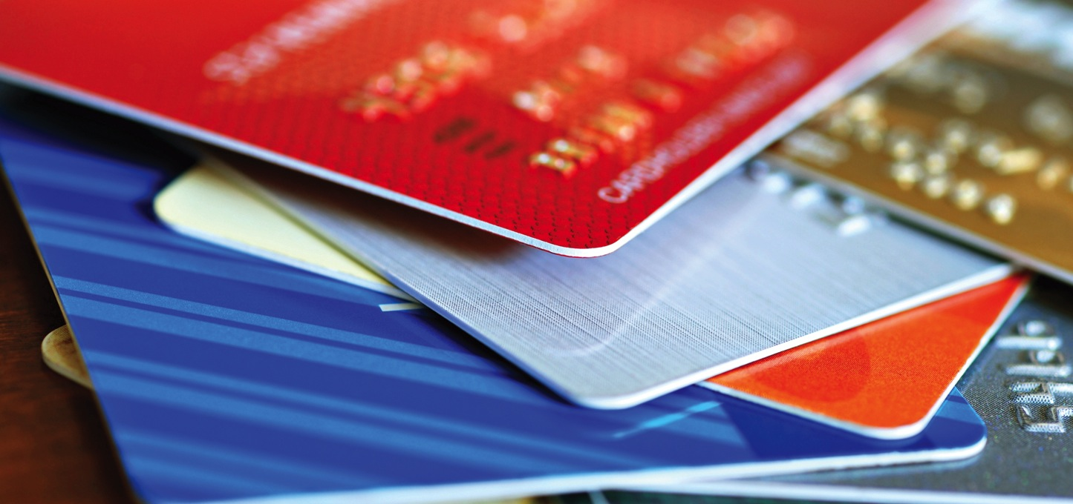
Borrowing is maxed out
$17 billion in debt from bond financing to build highways
Notes:
That’s what the state of Texas has chosen to do. In 2003, Texans voted to authorize the state – for the first time ever – to borrow money to build highways. Ten years later, our current credit card limit is about 17 billion dollars. If you include debt at the local level statewide, that total is 23 billion dollars. We are about to max out the state’s highway credit card.

Slide 13
Construction
Costs
What does this mean?
Everything costs more these days
Buying
Power
In the future we’ll have
less and less funding
as we move to fuel efficient cars
Notes:
The state has to pay that debt, including interest, at the same time that everything is costing more. Cement. Steel. Asphalt. The cost of highway materials gets higher every year. And at the same time, the state’s purchasing power shrinks. And as cars become more and more fuel efficient, purchasing power will shrink even more. That’s what happens when your paycheck stays the same for 20 years.

Slide 14
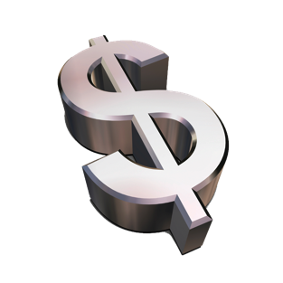
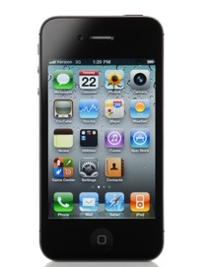
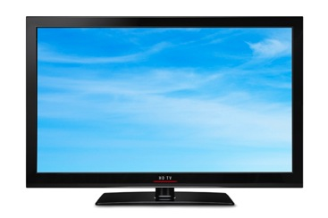

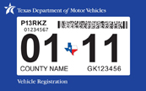
What does this
mean to me?
The average Texan pays:
$22/month
in state/federal gas taxes and auto fees
$128/month
Internet, phone, cable TV
$71/month
cell phone
Notes:
While we’re on the subject of what everything costs, it might be worthwhile to consider a few of those things to gain a little more perspective. Now, the gas mileage you get and the choices you make might make these numbers a little different from one person to another. And you also pay for county and city roads through property taxes and other fees. But this is what the average Texan pays for these things every month. 22 dollars a month in federal and state gas taxes and registration fees. That’s less than a dollar a day for something pretty important in your life – the highways we use.

Slide 15


So now what?
Get the biggest bang for the buck
  Tackle most congested roadways
  Improve
  safety
  Support biking, walking and mass transit options
Notes:
OK, then. If we’re in a hole that we really don’t want to be in, then how do we climb out? We can start with advice you’ve probably already heard … “if you find yourself in a hole, the first thing you should do is stop digging.” Let’s start by not letting this get any worse. We can do that by focusing on road projects that will give us the biggest bang for our buck. We can do that by focusing on safety. And we can do that by supporting land use decisions that support biking, walking and mass transit.

Slide 16
So now what?
Use our existing roads smarter
  Move crashes and stalls out of the way
  Time traffic signals so
  more see
  green
  Encourage carpooling
  Change rush
  hour nightmares through flex-time, telecommuting, etc.
Notes:
We should also focus on getting the most efficiency out of the roadways we have now. We should expect that our roadways are being used as efficiently as possible. And, we should expect that the most common sense techniques are applied to make sure we’re squeezing the most out of every dollar of transportation spending. These are the tools that are easy to understand – getting the crashes and stalled vehicles out of the way quickly, timing the traffic signals so that more cars get green lights. Putting more people in fewer cars. It’s also possible to offer flexible work hours or telecommuting options so that people can avoid rush hours and still get their jobs done. This is about re-thinking the way we do things.

Slide 17
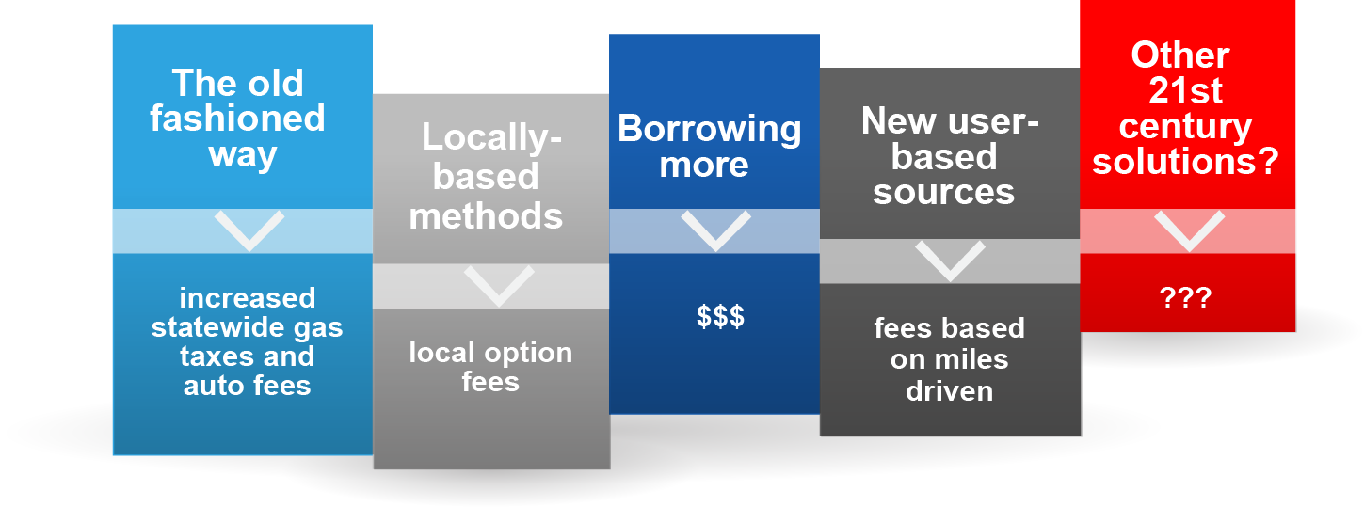
But all transportation improvements cost money
You can help choose the best method
Notes:
So, if the state were to do these things, how would they be paid for? Well, that’s partly up to you.
-- They could be paid for in the old-fashioned way – with gas tax revenue, or with higher registration fees for our cars, pickups and motorcycles.
-- They could also be paid for with a fee only for drivers who live in this region – a local-option fee – the money from which could only be used on projects in this region.
-- The state could borrow more money, but as we’ve seen, the credit card balance is already pretty high.
-- There’s also a concept called a road user fee, where you pay according to how many miles you drive – not according to how much gas you buy.
-- And there are other options, including re-directing some of our current state revenue to transportation. So if the question is “how will it be paid for?” the answer is partly up to you.

Slide 18
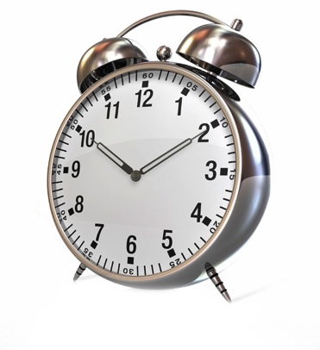
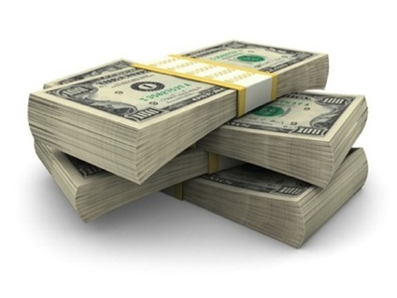
Here’s how the investment pays off
Notes:
The choice is largely ours to make, but if we choose to invest, the payoff will be big -- You’ll have more time for whatever you want to do, whether that’s with family, with friends, or just for you. You can be more sure that you’ll get where you want to go, sooner and safer, and more predictably. The economy will be stronger because businesses and customers can count on more dependable, on-time deliveries. And we can all count on a more healthy and stable job market.

Slide 19
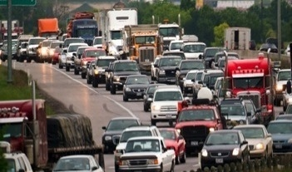
Is “doing nothing” really an option?
Notes:
Is “doing nothing” an option? Yes, but … Doing nothing means that you’ll spend more time stuck in traffic, so you’ll have less time to do what you really want to do. Doing nothing means you’ll spend more money on wasted gas, so you’ll have less money to spend on what you really want or need. Doing nothing means higher freight costs, so you’ll pay higher prices on just about everything that’s delivered by trucks. And doing nothing also means slower emergency response times. So, yes – doing nothing is, in fact, an option. But whether it’s an appealing option is a totally different question.

Slide 20

If you want a
change
http://mobility.tamu.edu/mip/rpm.php
Be better informed | Be more involved | Voice your OPINION
Notes:
We have important choices to make, and no matter which path we choose, our viewpoints and actions really should be based on facts and a clear understanding of the issues. It’s your roadway system. You have a part to play in what that system looks like and how it gets paid for, so I encourage you to do three things. First, be better informed. Second, be more involved. Third, voice your opinion.

